Slide 1
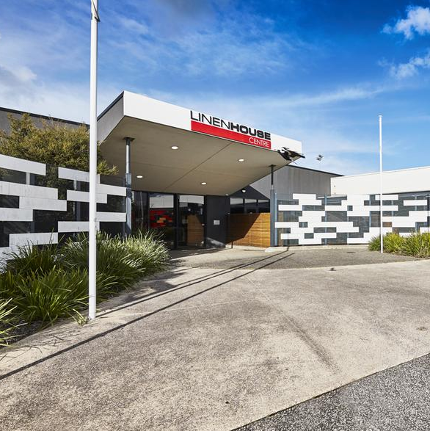



HEALTHY
FUTURES
HUB
HEALTHY FUTURES HUB
Creating a healthier community through partnership and innovation

Slide 2



Our vision is to create a health & wellbeing hub that serves the future needs of the community
COMMUNITY SPORT
Create a thriving environment to engage the Frankston community in physical health & fitness²
INTERGENERATIONAL FOCUS
Foster an environment that energises the older generations through frequent engagement with younger generations¹
ALL ABILITIES
Build confidence and support people with disabilities to ensure they live to their full potential³
Source: 2012 Frankston LGA Census
More 75+ year olds living alone (38% of 75+)
Fewer people meeting physical activity guidelines; More overweight and obese residents; 23% more mental health clients
28% more people receiving disability support pension; More than 12% of people aged over 65 live in the population with severe and profound disability

Slide 3
Our core offerings
PHYSICAL HEALTH
MENTAL HEALTH
FUTURE HEALTH
REHABILITATION SERVICES
GROUP EXERCISE CLASSES
GYM
HYDROTHERAPY
SPORTS PROGRAMS
MENTAL HEALTH PROGRAMS
INDIVIDUAL CONSULTATIONS
COMMUNITY CONNECTION
& SOCIAL ENTERPRISE
SIMULATED EXPERIENCES
DIGITAL-INCLUSION / TELEHEALTH
STUDENT PLACEMENTS
OUR VALUE PROPOSITION
WORLD-CLASS EXPERTISE
INTEGRATED SERVICES & FACILITY
EMPOWERING COMMUNITY PARTNERS
Collaboration with industry-leaders to deliver high quality programs & research
An integrated approach across our health professionals to ensure patients are well supported across their education and treatment so they only need to tell their story once
A platform for local community partners to grow through the shared customer based and knowledge of our partner network

Slide 4
What this site will deliver
A community asset - 90% of staff and their clients in the building relate to Not-For-Profits; Social enterprise café; Welcoming environment and “place to be” for locals
Drives investment into local community – Creation of a Community Fund to reinvest surplus revenues; Strong partnership group who can directly and indirectly invest into the facility and local area
Platform to drive local employment – More than 50 employees across 14 businesses
Delivers for local community needs outlined within the current FCC H&W plan – Disability, Aged and Community Football
Significant protections for council – Avoids any repeat of historical challenges and allows for rewiring of the partnership between Council and St Kilda
Committed partner group – Deep relationships across inaugural partners which will likely find further opportunities to collaborate and drive strong local outcomes

Slide 5
Benefits to Frankston
Champions primary health of the Frankston community, maximising usage of a facility that delivers on Priority Area 1.4 of the Healthy and Active Lives Strategic Goal in the FCC Health and Wellbeing Plan (2017-21)
Positions FCC as a community-partnership innovator within their prospective 2021-2025 Health and Wellbeing Plan
Expands partnerships for Frankston community benefit, with input from world- and national-leading organisations in their respective fields
Provides standard, low and no-cost, community-facing expert health, ageing and disability services to the citizens of the Frankston area
Belvedere Community Centre is able to work at its maximum capacity in collaborative models with key stakeholders within its field
Turns a closed building into an externally facing, multi-purpose facility with organisations who genuinely compliment each other
Creates opportunities to attract Government and third party investment into research and program development
Notes:
Long and detailed document
Past MOTPrac student project with Libby and Sue developed templated approach to supervision and delegation which we could further test and evaluate
These are the learning objectives we could use
Could be adapted for different populations.
Key Point: How do you develop a learning contract for students – be good to align Physio and OT student contracts
Explicit learning outcomes.
Use of co-design self- assessment for students – could ask students to complete at the start and at the end of placements.
There is a need to prep the students beforehand – in conjunction with Physio students
Augmented communication - need for student training on this – but much later with students so they have the framework to think about this.
Libby suggested resources we could use + Jan Mackay who is on this project.
OT looking to firm up prep for all placements. Can keep that in mind, and this project will help in developing these more general documents.
Revisit the manual as part of the project - Use higher education principles. Underpins one of the reasons why SPL is used.
But, doesn’t mean students can’t ask questions, as they are a learner.

Slide 6
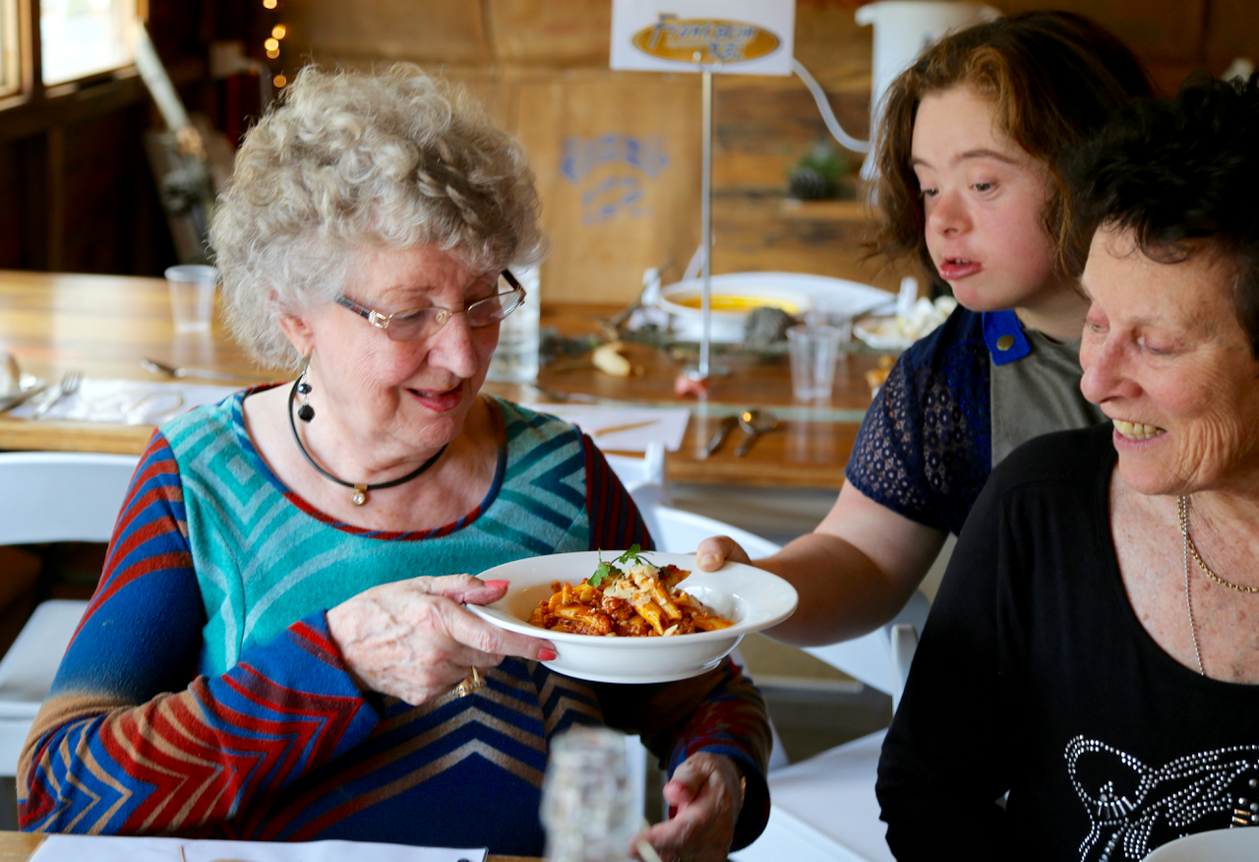
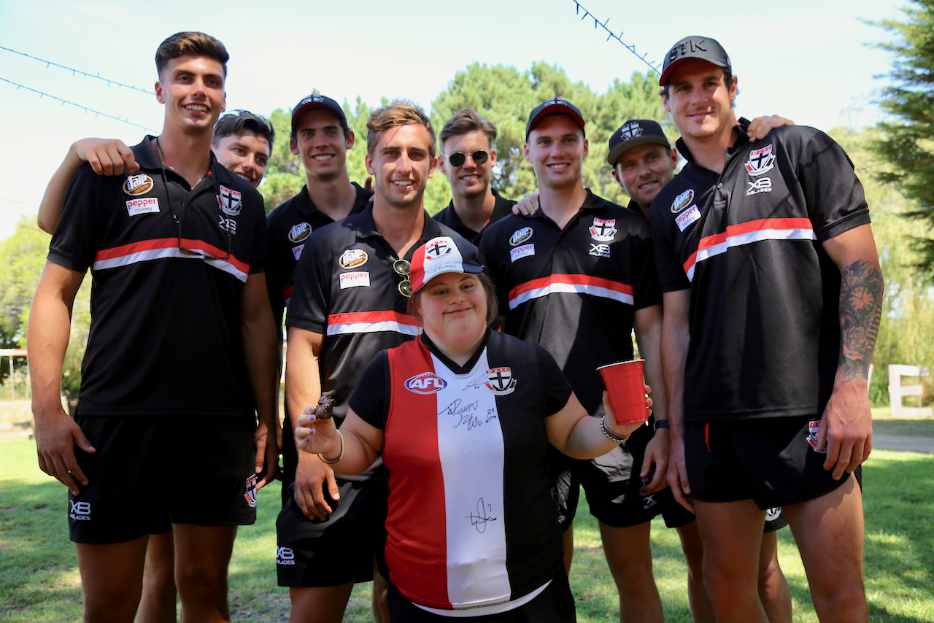
Intergenerational – All Abilities – Community Sport
Notes:
Long and detailed document
Past MOTPrac student project with Libby and Sue developed templated approach to supervision and delegation which we could further test and evaluate
These are the learning objectives we could use
Could be adapted for different populations.
Key Point: How do you develop a learning contract for students – be good to align Physio and OT student contracts
Explicit learning outcomes.
Use of co-design self- assessment for students – could ask students to complete at the start and at the end of placements.
There is a need to prep the students beforehand – in conjunction with Physio students
Augmented communication - need for student training on this – but much later with students so they have the framework to think about this.
Libby suggested resources we could use + Jan Mackay who is on this project.
OT looking to firm up prep for all placements. Can keep that in mind, and this project will help in developing these more general documents.
Revisit the manual as part of the project - Use higher education principles. Underpins one of the reasons why SPL is used.
But, doesn’t mean students can’t ask questions, as they are a learner.

Slide 7

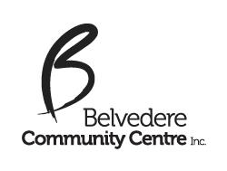
Social Inclusion programs
Adult Education classes
Community exercise classes
Art & Craft programs
Children & Family programs
Cooking & Cake decorating
Workshops & Events
Playgroups
Notes:
Long and detailed document
Past MOTPrac student project with Libby and Sue developed templated approach to supervision and delegation which we could further test and evaluate
These are the learning objectives we could use
Could be adapted for different populations.
Key Point: How do you develop a learning contract for students – be good to align Physio and OT student contracts
Explicit learning outcomes.
Use of co-design self- assessment for students – could ask students to complete at the start and at the end of placements.
There is a need to prep the students beforehand – in conjunction with Physio students
Augmented communication - need for student training on this – but much later with students so they have the framework to think about this.
Libby suggested resources we could use + Jan Mackay who is on this project.
OT looking to firm up prep for all placements. Can keep that in mind, and this project will help in developing these more general documents.
Revisit the manual as part of the project - Use higher education principles. Underpins one of the reasons why SPL is used.
But, doesn’t mean students can’t ask questions, as they are a learner.

Slide 8
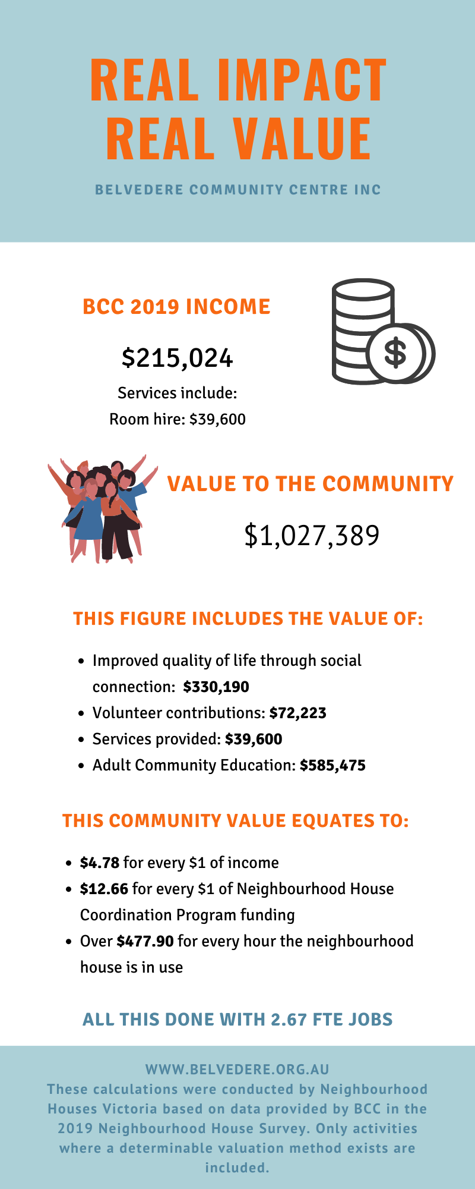
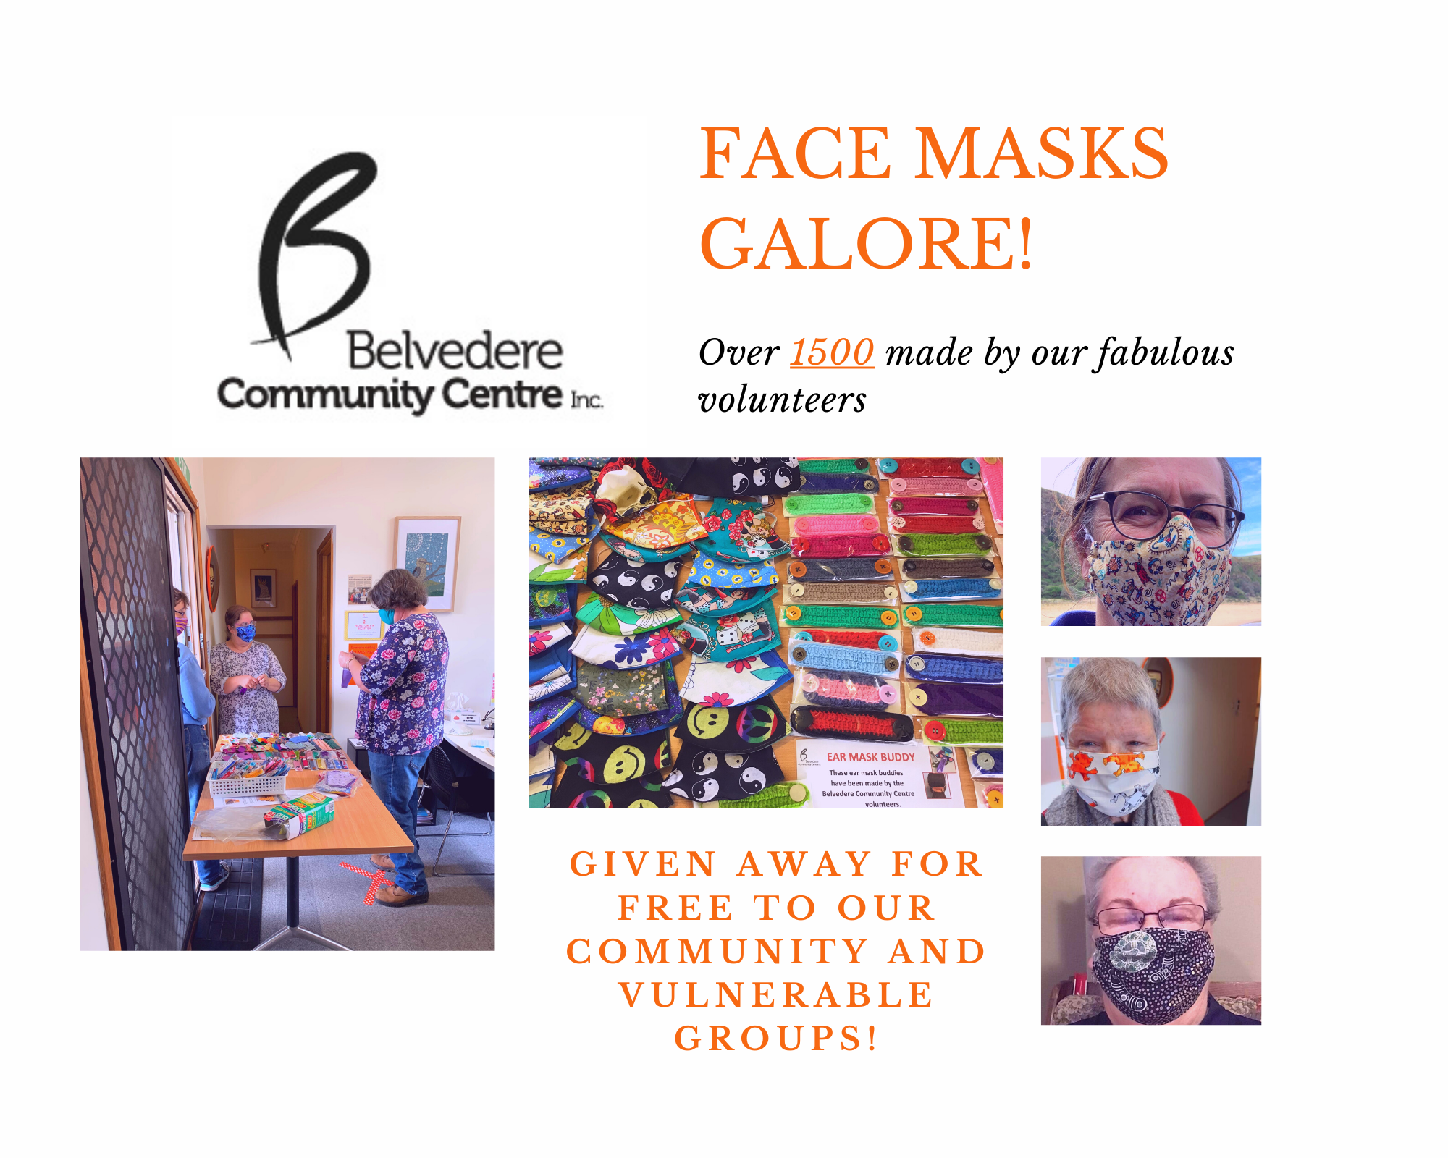

Slide 9
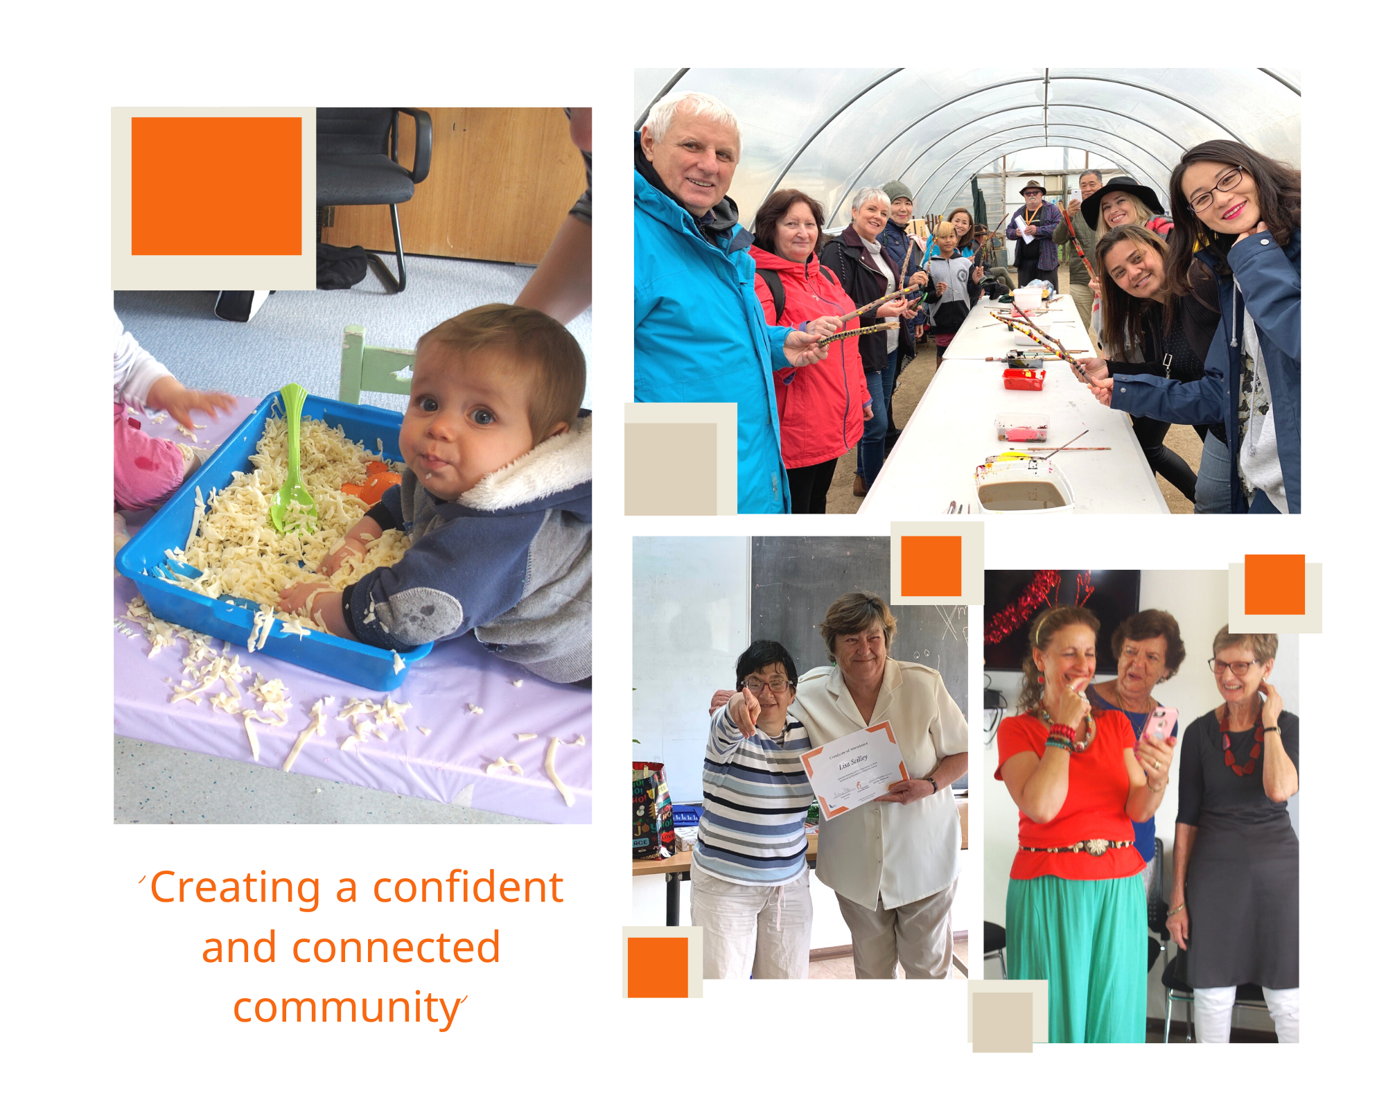

Slide 10
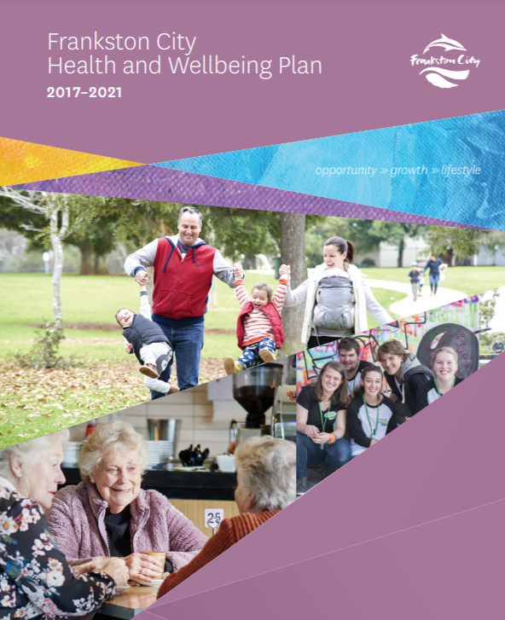
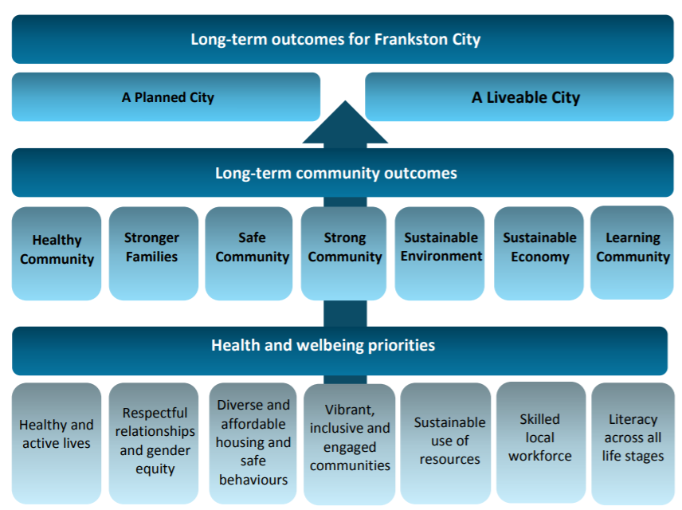
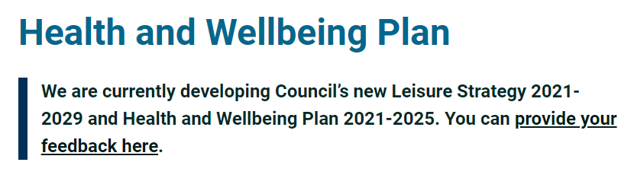
Appendix: Delivering against the FCC H&W strategy
Frankston City Council Health & Wellbeing Plan (2017-21), p.9

Slide 11
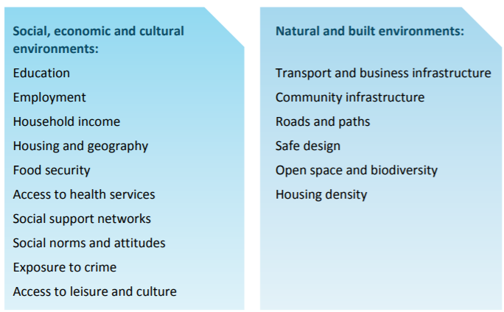
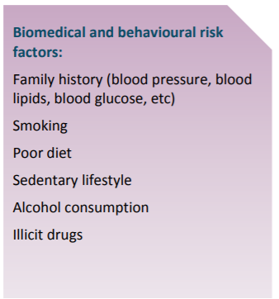
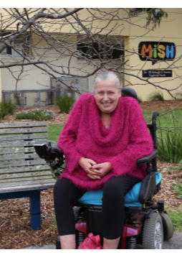
Appendix: Impacting key determinants of health
*
*
*
*
*
*
*
*
*
*
*
*
Frankston City Council Health & Wellbeing Plan (2017-21), p.11
Notes:
Long and detailed document
Past MOTPrac student project with Libby and Sue developed templated approach to supervision and delegation which we could further test and evaluate
These are the learning objectives we could use
Could be adapted for different populations.
Key Point: How do you develop a learning contract for students – be good to align Physio and OT student contracts
Explicit learning outcomes.
Use of co-design self- assessment for students – could ask students to complete at the start and at the end of placements.
There is a need to prep the students beforehand – in conjunction with Physio students
Augmented communication - need for student training on this – but much later with students so they have the framework to think about this.
Libby suggested resources we could use + Jan Mackay who is on this project.
OT looking to firm up prep for all placements. Can keep that in mind, and this project will help in developing these more general documents.
Revisit the manual as part of the project - Use higher education principles. Underpins one of the reasons why SPL is used.
But, doesn’t mean students can’t ask questions, as they are a learner.

